Slide 1

VIDEO FRAME PREDICTION
Presented By :
Harshavardana Reddy Kolan
Sriram Sathwik Tippavaram
Shrihan Thokala
The George Washington University | 2024

Slide 2
1
OVERVIEW
Introduction
Methodology
Challenges
Applications
Implementation
Conclusion
Dataset
Result
The George Washington University | 2024

Slide 3

2
INTRODUCTION
The ability to predict future frames in a video sequence has significant implications for various applications, from autonomous vehicle navigation to enhanced video compression techniques.
This project explores the use of deep learning algorithms to forecast the next frames in a video based on previously observed sequences.
The predictive model aims to understand and replicate the dynamics and appearance of real-world scenes captured in video data.
The George Washington University | 2024

Slide 4
6
ABOUT THE DATASET
The dataset is taken from caltech pedestrian dataset
Source: https://data.caltech.edu/records/f6rph-90m20
The dataset contains 11.8GB in the form .seq file
This dataset contains low-resolution video footage from a moving vehicle with frequent occlusions of pedestrian, making it perfect for testing predictive video frame technologies.
It is useful for evaluating the robustness of video analysis algorithms in unpredictable environments.
The George Washington University | 2024

Slide 5
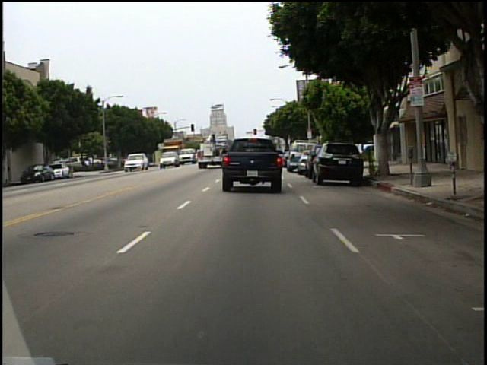
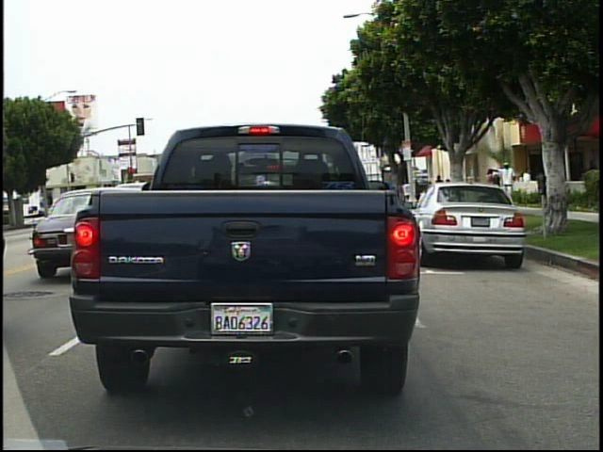
5
ABOUT THE DATASET
The George Washington University | 2024

Slide 6
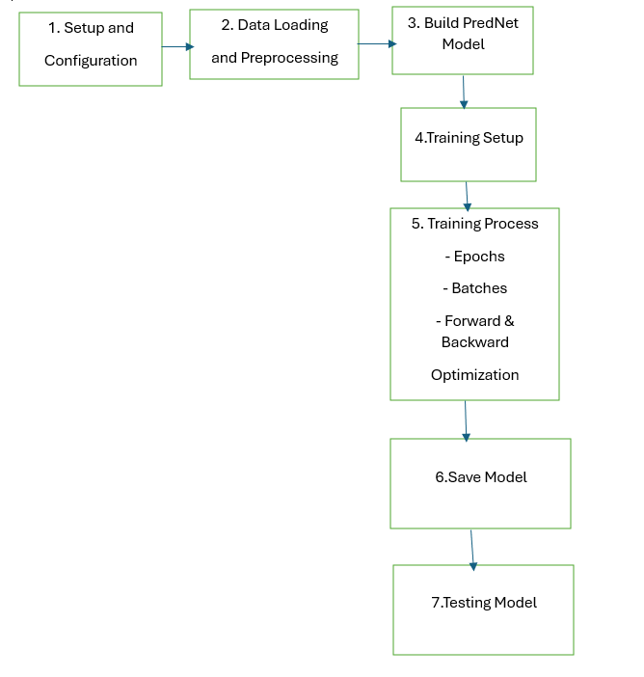
6
METHODOLOGY
The George Washington University | 2024

Slide 7
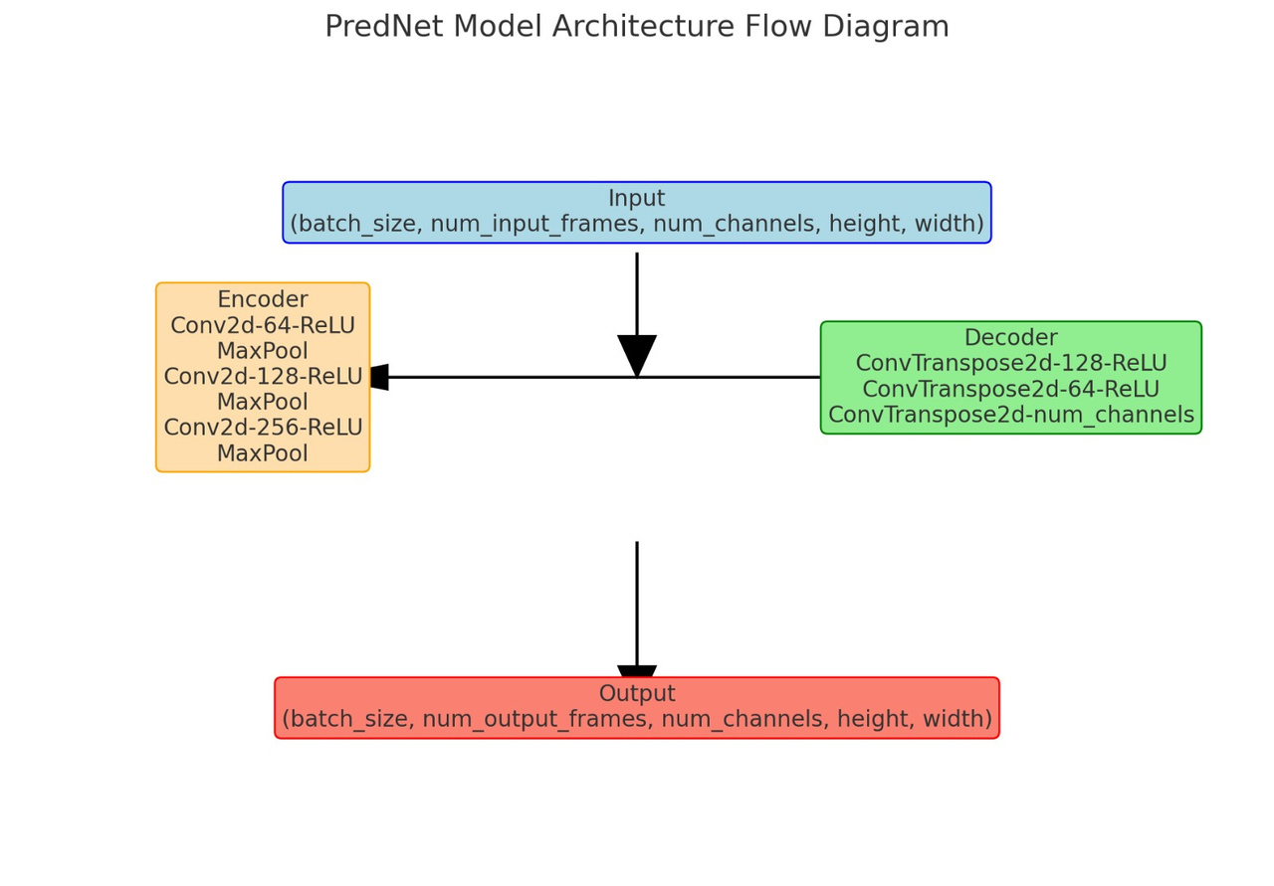
5
ARCHITECTURE
The George Washington University | 2024

Slide 8
7
IMPLEMENTATION
Phase 1
Phase 3
Automated Extraction of Frames from Sequence Files
Neural Network Architecture and Training
The George Washington University | 2024
Phase 2
Phase 4
Data Preparation and Normalization
Test Data Preparation and Model Evaluation

Slide 9
8
IMPLEMENTATION
Automated Extraction of Frames from Sequence Files:
Sequence.py converts all available video data to a frame-by-frame image format by iterating over .seq files in designated directories.
We use OpenCV to extract every frame and save it as a JPEG image, making the data accessible for frame-based image processing and analysis in machine learning workflows.
The George Washington University | 2024

Slide 10
9
IMPLEMENTATION
Data Preparation and Normalization:
To process a dataset of frames, we read each frame and convert it from BGR to RGB format, resize it to 320x320 pixels, and normalize the pixel values to a range of 0 to 1.
For training, we organize the frames into sequences and use consecutive frames (num_input_frames) to predict the next frame (num_output_frames). This approach mimics the temporal continuity in videos, which is essential for the model to understand and predict motion dynamics.
The George Washington University | 2024

Slide 11
10
IMPLEMENTATION
Neural Network Architecture and Training:
This model uses a Convolutional Neural Network (CNN) based encoder-decoder architecture. The encoder compresses input frames into a latent space representation, and the decoder reconstructs the future frame from this representation. ReLU activation functions and max pooling help in feature extraction and reducing dimensionality.
The training process involves using Mean Squared Error (MSE) loss function and the Adam optimizer. The model is trained over several epochs, with progress monitored through the calculation of loss at each step.
The George Washington University | 2024

Slide 12
11
IMPLEMENTATION
Test Data Preparation and Model Evaluation
During testing, images are read from disk, converted to RGB, resized to 320x320, and normalized to a [0, 1] range. This ensures consistency with the training phase, which is crucial for model accuracy and performance.
The trained model's parameters are loaded and evaluated using model.eval(), which maintains consistent performance metrics across test sets by disabling dropout layers and batch normalization.
The George Washington University | 2024

Slide 13
12
RESULTS
Visualization and Output Comparison:
Our implemented function predicts frames based on test data and compiles them into a GIF for easy visualization.
The function also generates a video from the original frames at every 30th interval for comparative purposes. This helps in assessing the accuracy and visual fidelity of the model's predictions.
The George Washington University | 2024

Slide 14
12
CHALLENGES
We tried Generative Adversarial Network (GAN) to generate and differentiate between real and generated frames. One network (the generator) predicts future frames based on given images, and another network (the discriminator) distinguishes between the real and generated frames.
We tried a ConvLSTM network for predicting future video frames. This network combines convolutional layers for spatial relationships within frames and LSTM layers for temporal dynamics across a sequence of frames. This architecture is useful for tasks like video prediction and anomaly detection in temporal sequences.
But these models were too complex to be implemented even with the alloted GPUs.
The George Washington University | 2024

Slide 15
3
APPLICATIONS
1
Enhancing real-time decision-making by predicting future states of the environment, allowing vehicles to anticipate possible changes in their surroundings and react proactively.
The George Washington University | 2024
Improving compression efficiency by predicting successive frames, thereby reducing the need to store and transmit redundant information.
2
3
Enhancing security monitoring by predicting and alerting about potential future events, thus enabling preemptive actions and responses.

Slide 16

13
CONCLUSION
We successfully developed a deep learning model that enhances the prediction accuracy of future video frames, leveraging advanced neural network architectures like CNNs and LSTMs.
The clarity of the videos generated can be further improved by using complex models such as GAN, ConvLSTM.
The George Washington University | 2024

Slide 17
THANK YOU

